Slide 1
IR 101 The analyst mindset
@juju43, Defcon 31, Aug 2023
Notes:
Last updated: 2023/05/14

Slide 2
Disclaimer
Be responsible
Be respectful
Be trustworthy
Your investigation can decide to discipline or fire someone,
in some case to send to jail and maybe more.
That’s a giant responsibility. Don’t take it lightly.

Slide 3
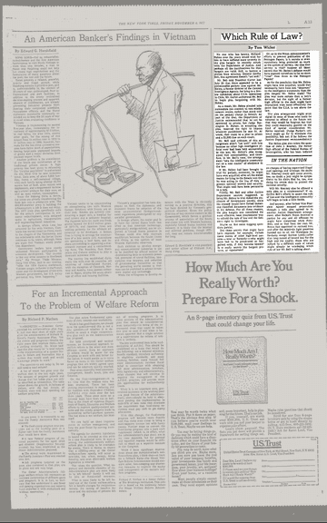
Peer review or dual control
Which Rule of Law? New York Times
Most investigations but the basic ones can and should be reviewed by your internal peers, management and internal auditors.
Depending on context, it may be reviewed by external auditors, lawyers and journalists.
Not all investigations are equals. "Choose your battle" but ensure to document and communicate limitations and tradeoffs to your team and management.
Notes:
https://www.nytimes.com/1977/11/04/archives/which-rule-of-law.html

Slide 4
Mindset

Slide 5

Questioning mindset
Notes:
Credits: https://www.wallpaperflare.com/question-mark-drawing-why-problem-solution-think-chalk-board-wallpaper-zzmun

Slide 6
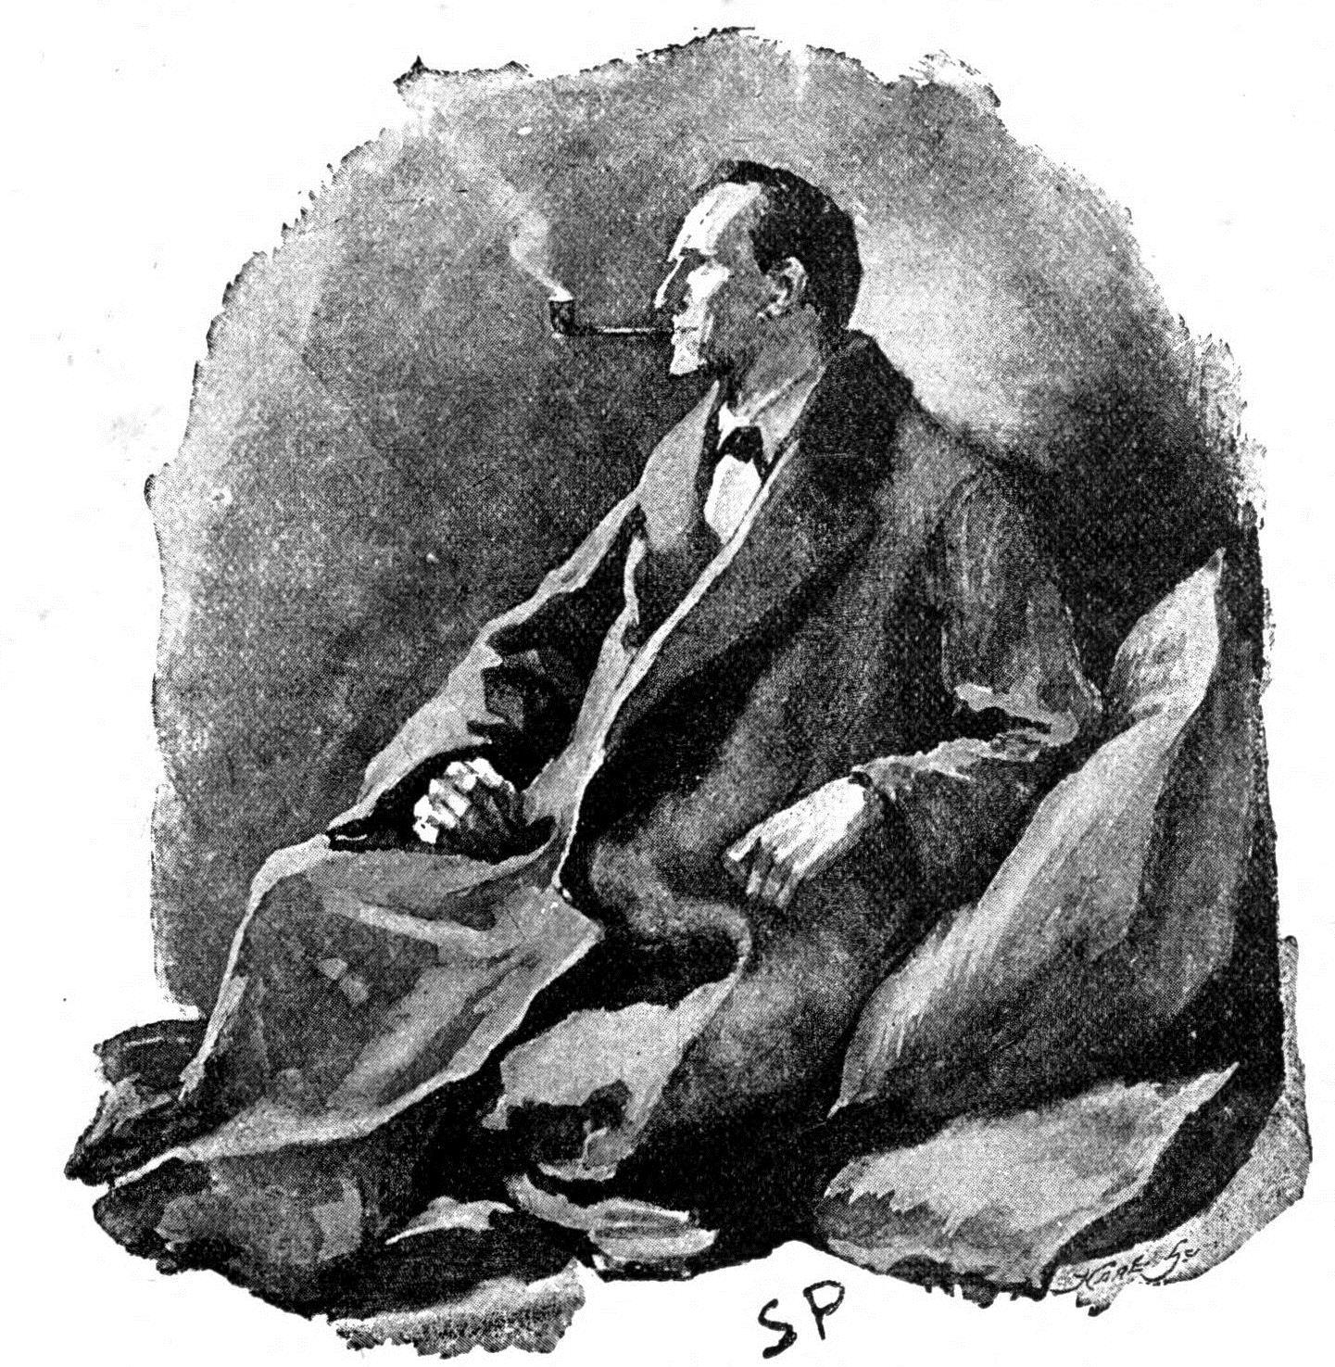
Detective mindset
Notes:
Credits: https://commons.wikimedia.org/wiki/File:Sherlock_Holmes_-_The_Man_with_the_Twisted_Lip.jpg

Slide 7
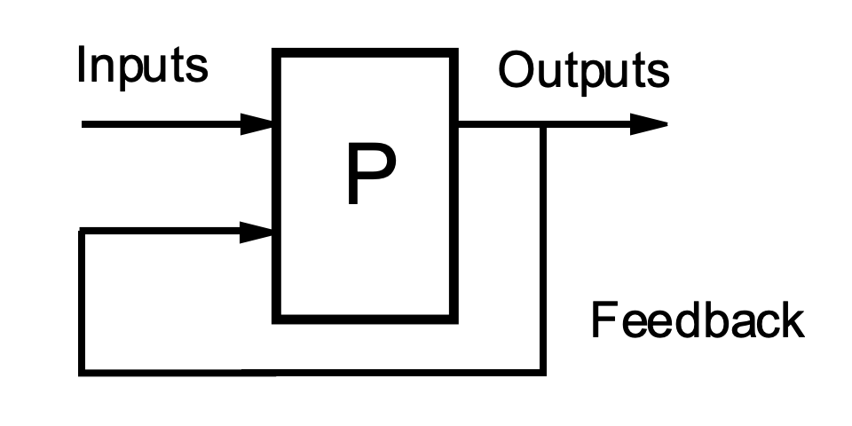
Feedback loop
There is no perfection. Small or big, there is always something to share, improve.
If none, it is likely you did not use enough the process or tool.
Notes:
Credits: https://en.wikipedia.org/wiki/Feedback

Slide 8
Or is it just science?
Observation, Skepticism, Hypotheses, Test/Validate
https://en.wikipedia.org/wiki/Scientific_method

Slide 9
What about Security Incident?

Slide 10

Don't panic!
Notes:
Credits: The Hitchhiker's Guide To The Galaxy, https://en.wikipedia.org/wiki/The_Hitchhiker%27s_Guide_to_the_Galaxy

Slide 11
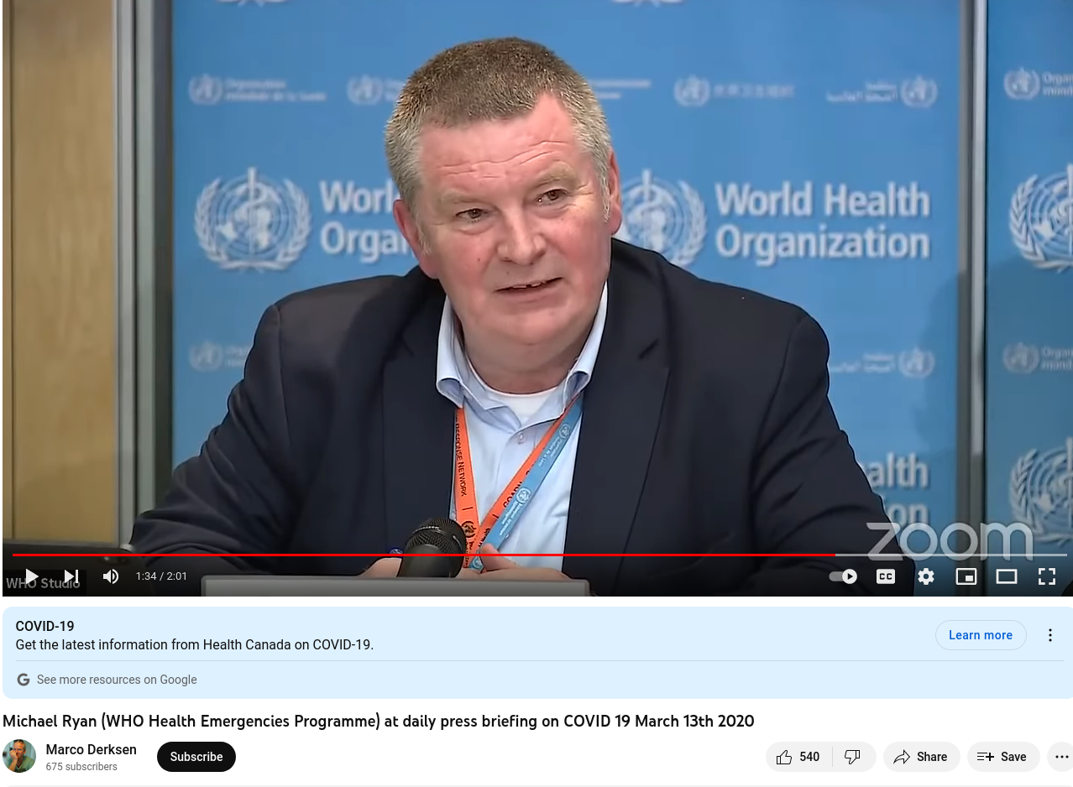
Act fast!
“Perfection is the enemy of the good when it comes to emergency management. Speed trumps perfection … The greatest error is not to move. The greatest error is to be paralyzed by the fear of failure. If you need to be right before you move, you will never win.", Michael Ryan (WHO Health Emergencies Programme), March 2020
Notes:
[“Perfection is the enemy of the good when it comes to emergency management. Speed trumps perfection … The greatest error is not to move. The greatest error is to be paralyzed by the fear of failure. If you need to be right before you move, you will never win.", Michael Ryan (WHO Health Emergencies Programme) at daily press briefing on COVID 19 March 13th 2020](https://www.youtube.com/watch?v=AqRHH6e-y6I)
[We are in a race to save lives right now and as my colleague Dr. Mike Ryan said back in March last year, it’s important in any crisis to act fast and have no regrets, WHO, Jan 2021](https://www.who.int/director-general/speeches/detail/opening-remarks-for-the-media-briefing-on-covid-19-5-january-2021)

Slide 12
Act fast does not mean reckless
Your team and leaders are here to help, listen and talk
Documentation is key

Slide 13
Example: Isolate system action
Isolating end-user system should never be issue (VIP…)
If your server environment is resilient, maybe
If it is fragile and/or legacy, always engage business owner before
Likely exception if confident seeing a data exfiltration or compromise
Should be known and agreed beforehand with your leadership
Should be in your documentation
Match your company risk appetite

Slide 14
Investigate
Process and methodology can vary but usually the main goals of an investigation are:
Minimize impact of the incident
Ensure lessons learned are done to be better prepared next time
Have a playbook or Standard Operating Procedure.
Step by step methodologies, must, optional parts.

Slide 15
Some methodologies
5 Ws - Who, What, When, Where, Why, (How)
5 Why’s
Observe, Orient, Decide, Act or OODA Loop, John Boyd
Known Knowns, Known Unknowns - Donald Rumsfeld
Analysis of Competing Hypotheses - Richards (Dick) J. Heuer, Jr., CIA
Diamond Model - Threat Intelligence
Investigative Mindset, Chris Sanders
None better than another. It depends.
Notes:
ACH: likely hypothesis based on evidences that eliminates others hypothesis
Diamond Model: Adversary, Infrastructure, Victim, Capability

Slide 16
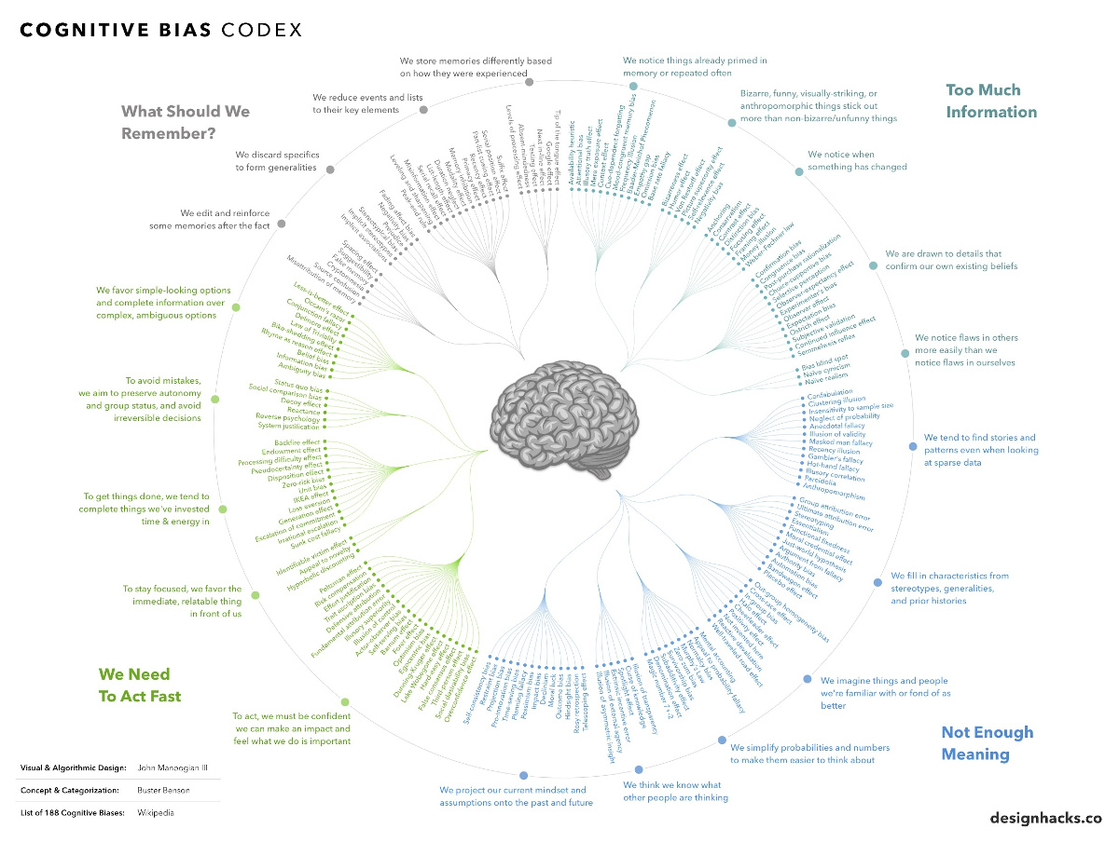
Be mindful of Bias
Human mind is a maze and often is taking shortcuts for good or bad reasons
Notes:
Examples
Similarity Bias — We prefer what is like us over what is different
Expedience Bias — We prefer to act quickly rather than take time
Experience Bias — We take our perception to be the objective truth
Distance Bias — We prefer what’s closer over what’s farther away
Safety Bias — We protect against loss more than we seek out gain

Slide 17
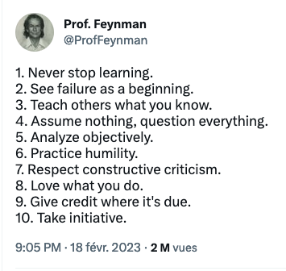
Summary
Ask questions, Make Hypotheses, Validate, Repeat
Be a lifelong learner, be hungry for knowledge
Fail fast, don’t be afraid of fire
Know your goals and expectations from leadership
Find what you like
Help others
Notes:
[1. Never stop learning.2. See failure as a beginning.3. Teach others what you know.4. Assume nothing, question everything.5. Analyze objectively.6. Practice humility.7. Respect constructive criticism.8. Love what you do.9. Give credit where it's due.10. Take initiative. Feb 2023](https://twitter.com/ProfFeynman/status/1627127271671861249)

Slide 19
References - Methodologies
5 Ws
5 Why’s
Known Knowns, Known Unknowns - Donald Rumsfeld
Analysis of Competing Hypotheses - Richards (Dick) J. Heuer, Jr., CIA
Analysis_of_competing_hypotheses (wikipedia)
psychology-of-intelligence-analysis art11 (web.archive.org), psychology-of-intelligence-analysis (cia.gov)
Diamond Model - Threat Intelligence
Investigation Theory Training, Chris Sanders
Notes:
https://en.wikipedia.org/wiki/Five_whys

Slide 20
References - Bias
https://en.wikipedia.org/wiki/List_of_cognitive_biases
https://mediasonar.com/2019/07/24/cognitive-biases-investigations/
https://www.visualcapitalist.com/every-single-cognitive-bias/
Overcoming Cognitive Biases During Threat Hunts and Incident Response, Sep 2019
Through Your Mind’s Eye: What Biases Are Impacting Your Security Posture? McAfee, May 2021
Correcting Prevention Bias in Your OT Cyber Incident Response, Dragos, Jul 2021
Avoiding Cognitive Bias in Your Investigations, Maltego, Oct 2022
Common Cyber Threat Intel Biases, Matt Richard, May 2023

Slide 21
References – Twitter misc
Life-long student mentality is key to success as a SOC analyst, that's one of the things I learned from @jhencinskiand the leadership at @expel_io. Great advice here in the blog, and I think experience as a SOC analyst can take you literally anywhere you'
5 helpful habits for aspiring #SOC analysts 1. Survey the field, #FF folks like @stvemillertime 2. Combine reading & practice 3. Seek learning, not just reading 4. Develop an attacker mindset 5. Be dauntless! Apply, maybe you get a no. Try again! Apr 2021
It’s sometimes hard to remember as a security professional that other people generally don’t see the world in terms of what criminals and pranksters will *for sure* exploit, constantly, and what the result will be. They don’t. It’s not common. Apr 2021
1. Never stop learning.2. See failure as a beginning.3. Teach others what you know.4. Assume nothing, question everything.5. Analyze objectively.6. Practice humility.7. Respect constructive criticism.8. Love what you do.9. Give credit where it's due.10. T
Struggling to find ‘bad’ in your SIEM? Here are two simple tips.1. Pivot. Ok so X user created an alert for being added to a privileged group. Obviously check the user account itself, but then pivot to the asset , what events occurred on it during the tim

